Slide 1


Advanced Topics
Travis Hance (and the Verus Team)
MPI-SWS (to join soon)
https://verus.rs/

Slide 2

Interior mutability
Unsafe Code
Notes:
I’m going to be talking about 3 big topics today – interior mutability, unsafe code, and concurrency
[poll audience if they know what interior mutability, unsafe code are]
These 3 topics are actually highly interrelated, in that any code using 1 of them is very likely using 1 of the others as well. To verify significant systems requires us to be proficient in the art of composing all the related concepts. For this talk, though, I’ll try to distill each to its essence and a present a self-contained introduction to each, at least for the first 2.

Slide 3
Interior mutability

Slide 4

What is interior mutability?
Rust’s references are usually described to new users as follows:
Type
&mut T | Unique | Mutable
&T | Shared | Immutable
Unfortunately it’s not entirely correct …
Sometimes described as “shared XOR mutable,” this is an important property that enables Rust’s memory safety & Verus’s efficient SMT encoding

Slide 5
What is interior mutability?
Interior mutability is a pattern wherein you can modify data behind a shared reference (&).
However, this is only possible through specialized “interior mutability” types (e.g., Cell, RefCell, Mutex, RwLock, UnsafeCell)
This is good, because unrestricted mutation-through-& would ruin all the theory behind Verus’s encoding
As it is, we can restrict the additional complexity only to when these specialized types are involved

Slide 6
Example: Memoizing a deterministic fn
In this exercise, we’ll:
Motivate the need for interior mutability
Encapsulate the interior mutability behind a clean interface
Verify it with Verus

Slide 7
Example: Memoizing a deterministic fn
Suppose we have some expensive but deterministic computation
pub fn expensive_function(args: &Args) -> Output {
/* ... */
}
struct Memoizer {
map: HashMap<Args, Output>
}
impl Memoizer {
pub fn get(&mut self, args: &Args) -> Output {
match self.map.get(args) {
Some(result) => result.clone(),
None => {
// Compute for the first time and store the result for next time
let result = expensive_function(args);
self.map.insert(args.clone(), result.clone());
result
}
}
}
}
We can memorize the results — lazily populate a lookup—table of results, as-needed

Slide 8
Example: Memoizing a deterministic fn
Now, what if we want to share the Memoizer across multiple subsystems? Maybe even across threads?
Arc<Memoizer> → &Memoizer
Whoops, now we can’t call get —
fn get(&mut self, args: &Args)

Slide 9
Example: Memoizing a deterministic fn
pub fn expensive_function(args: &Args) -> Output {
/* ... */
}
struct Memoizer {
map: HashMap<Args, Output>
}
impl Memoizer {
pub fn get(&mut self, args: &Args) -> Output {
match self.map.get(args) {
Some(result) => result.clone(),
None => {
// Compute for the first time and store the result for next time
let result = expensive_function(args);
self.map.insert(args.clone(), result.clone());
result
}
}
}
}

Slide 10
Example: Memoizing a deterministic fn
We really want to implement this instead:
fn get(&self, args: &Args)
And this is why we need interior mutability.
We have a few choices:
Cell
RefCell
Mutex
RwLock

Slide 11
Example: Memoizing a deterministic fn
We really want to implement this instead:
fn get(&self, args: &Args)
And this is why we need interior mutability.
We have a few choices:
Cell
RefCell
Mutex
RwLock
Not thread-safe; single-threaded sharing only

Slide 12
Example: Memoizing a deterministic fn
We really want to implement this instead:
fn get(&self, args: &Args)
And this is why we need interior mutability.
We have a few choices:
Cell
RefCell
Mutex
RwLock
Not thread-safe; single-threaded sharing only
Thread safe; can be shared across threads

Slide 13
Example: Memoizing a deterministic fn
We really want to implement this instead:
fn get(&self, args: &Args)
And this is why we need interior mutability.
We have a few choices:
Cell
RefCell
Mutex
RwLock
(I’m not going to be optimizing thread contention or anything, and I’m only choosing RwLock because it has the best Verus support)
Not thread-safe; single-threaded sharing only
Thread safe; can be shared across threads

Slide 14
Example: Memoizing a deterministic fn
pub fn expensive_function(args: &Args) -> Output {
/* ... */
}
struct Memoizer {
lock: RwLock<HashMap<Args, Output>>
}
impl Memoizer {
pub fn get(&mut self, args: &Args) -> Output {
let map_handle = self.lock.write().expect();
match map_handle.get(args) {
Some(result) => result.clone(), None => {
// Compute for the first time and store the result for next time
let result = expensive_function(args);
map_handle.insert(args.clone(), result.clone());
result
}
}
}
}
With Rust’s RwLock, the lock is automatically released when handle goes out of scope.
Note though this isn’t true for Verus’s RwLock in vstd

Slide 15
Example: Memoizing a deterministic fn
pub fn expensive_function(args: &Args) -> Output {
/* ... */
}
struct Memoizer {
ref_cell: RefCell<HashMap<Args, Output>>
}
impl Memoizer {
pub fn get(&self, args: &Args) -> Output {
let map_handle = self.ref_cell.borrow_mut();
match map_handle.get(args) {
Some(result) => result.clone(), None => {
// Compute for the first time and store the result for next time
let result = expensive_function(args);
map_handle.insert(args.clone(), result.clone());
result
}
}
}
}

Slide 16
Example: Memoizing a deterministic fn
pub fn expensive_function(args: &Args) -> Output {
/* ... */
}
struct Memoizer {
lock: RwLock<HashMap<Args, Output>>
}
impl Memoizer {
pub fn get(&self, args: &Args) -> Output {
let map_handle = self.lock.write().expect();
match map_handle.get(args) {
Some(result) => result.clone(), None => {
// Compute for the first time and store the result for next time
let result = expensive_function(args);
map_handle.insert(args.clone(), result.clone());
result
}
}
}
}
Which type you want to use depends on your specific requirements, but verification will likely use the same basic idea in any case.

Slide 17
[RwLock demo]

Slide 18
Verifying the memoizer
Start with the spec:
pub spec fn func(args: &Args) -> Output { ... }
pub fn expensive_function(args: &Args) -> (output: Output)
ensures output == func(args)
{ ... }
impl Memoizer {
pub fn get(&self, args: &Args) -> Output
ensures output == func(args)
{ ... }
}
Function must be deterministic
Memoizer is deterministic and computes the same function

Slide 19
Verifying the memoizer
Start with the spec:
pub spec fn func(args: &Args) -> Output { ... }
pub fn expensive_function(args: &Args) -> (output: Output)
ensures output == func(args)
{ ... }
impl Memoizer {
pub fn get(&self, args: &Args) -> Output
ensures output == func(args)
{ ... }
}
Function must be deterministic
Memoizer is deterministic and computes the same function
Observe again how the interior mutation is encapsulated

Slide 20
Example: Memoizing a deterministic fn
pub fn expensive_function(args: &Args) -> Output {
/* ... */
}
struct Memoizer {
lock: RwLock<HashMap<Args, Output>>
}
impl Memoizer {
pub fn get(&self, args: &Args) -> Output {
let map_handle = self.lock.write().expect();
match map_handle.get(args) {
Some(result) => result.clone(), None => {
// Compute for the first time and store the result for next time
let result = expensive_function(args);
map_handle.insert(args.clone(), result.clone());
result
}
}
}
}
To prove the spec, we can apply a lock invariant here

Slide 21
One last question
Verus relies on this property — “shared XOR mutable,” that no state is mutable and shared at the same time — for its efficient SMT encoding.
Interior mutability breaks this property, yet Verus can still support it. How is this possible?

Slide 22
Unsafe Code

Slide 23
Unsafe Code

Slide 24

What is unsafe code?
Definition attempt #1:
Unsafe code is code that opts the programmer out of the memory-safety guaranteed by Rust’s type system
fn oh_no() {
let p: *mut u64 = std::ptr::null_mut();
unsafe {
*p = 20;
}
}

Slide 25
What is unsafe code?
Definition attempt #1:
Unsafe code is code that opts the programmer out of the memory-safety guaranteed by Rust’s type system
fn oh_no() {
let p: *mut u64 = std::ptr::null_mut();
unsafe {
*p = 20;
}
}
This seems pretty bad — doesn’t Verus rely on this?

Slide 26
What is unsafe code?
Definition attempt #2:
Unsafe code is code that has additional requirements (beyond Rust’s type checker) to guarantee memory safety

Slide 27
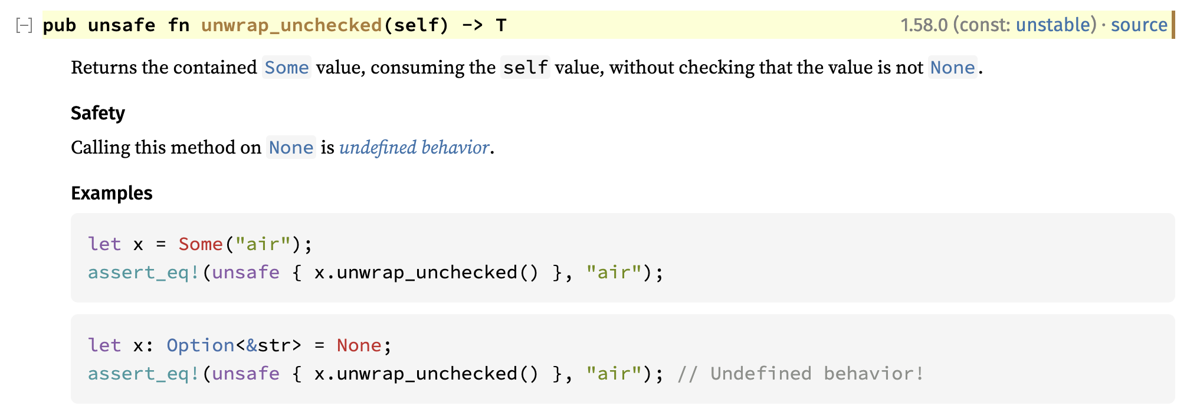
Example: Option::unwrap_unchecked
The subtext here is that behavior is defined if self is Some(_)
https://doc.rust-lang.org/std/option/enum.Option.html#method.unwrap_unchecked

Slide 28
What is unsafe code?
Unsafe code is really Conditionally Safe code — if the condition is satisfied, then it is safe
impl<T> Option<T> {
fn unwrap_unchecked(self) -> (res: T)
requires self.is_some()
ensures self == Some(res)
{
/* ... */
}
}
These conditions can be made explicit and formal using Verus preconditions

Slide 29
Unsafe Code

Slide 30

Unsafe Code
Notes:
Put this way, unsafe code doesn’t sound so bad. “Unsafe code” just means it has a requires clause, which is what you all have been practicing with all day. But —

Slide 31

Unsafe pointers

Slide 32
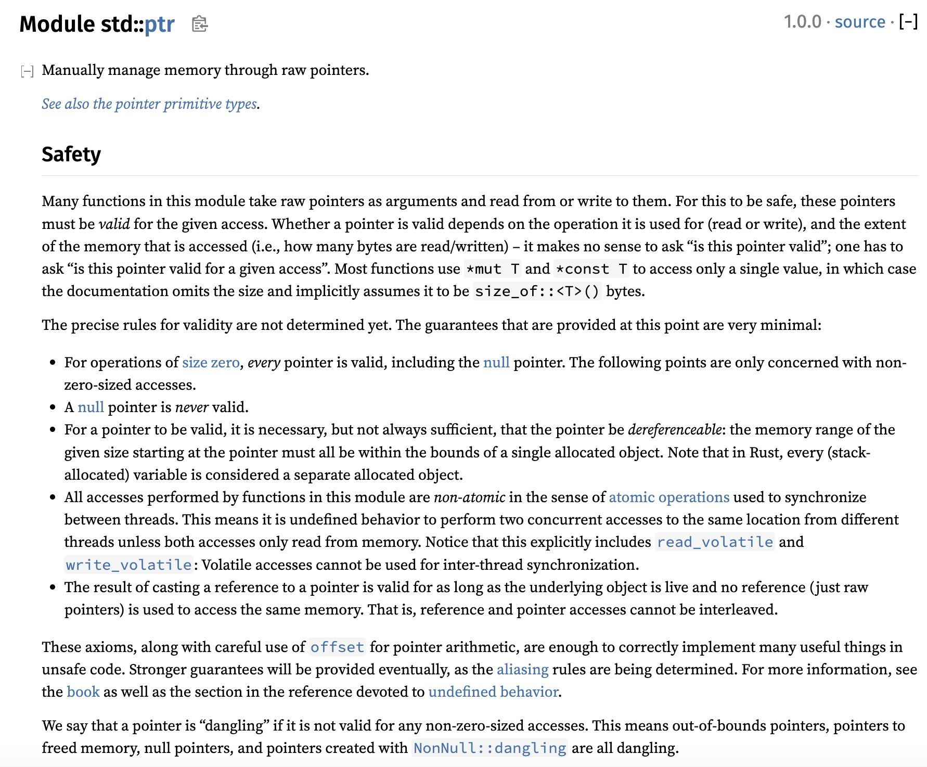
Let’s check the docs again

Slide 33
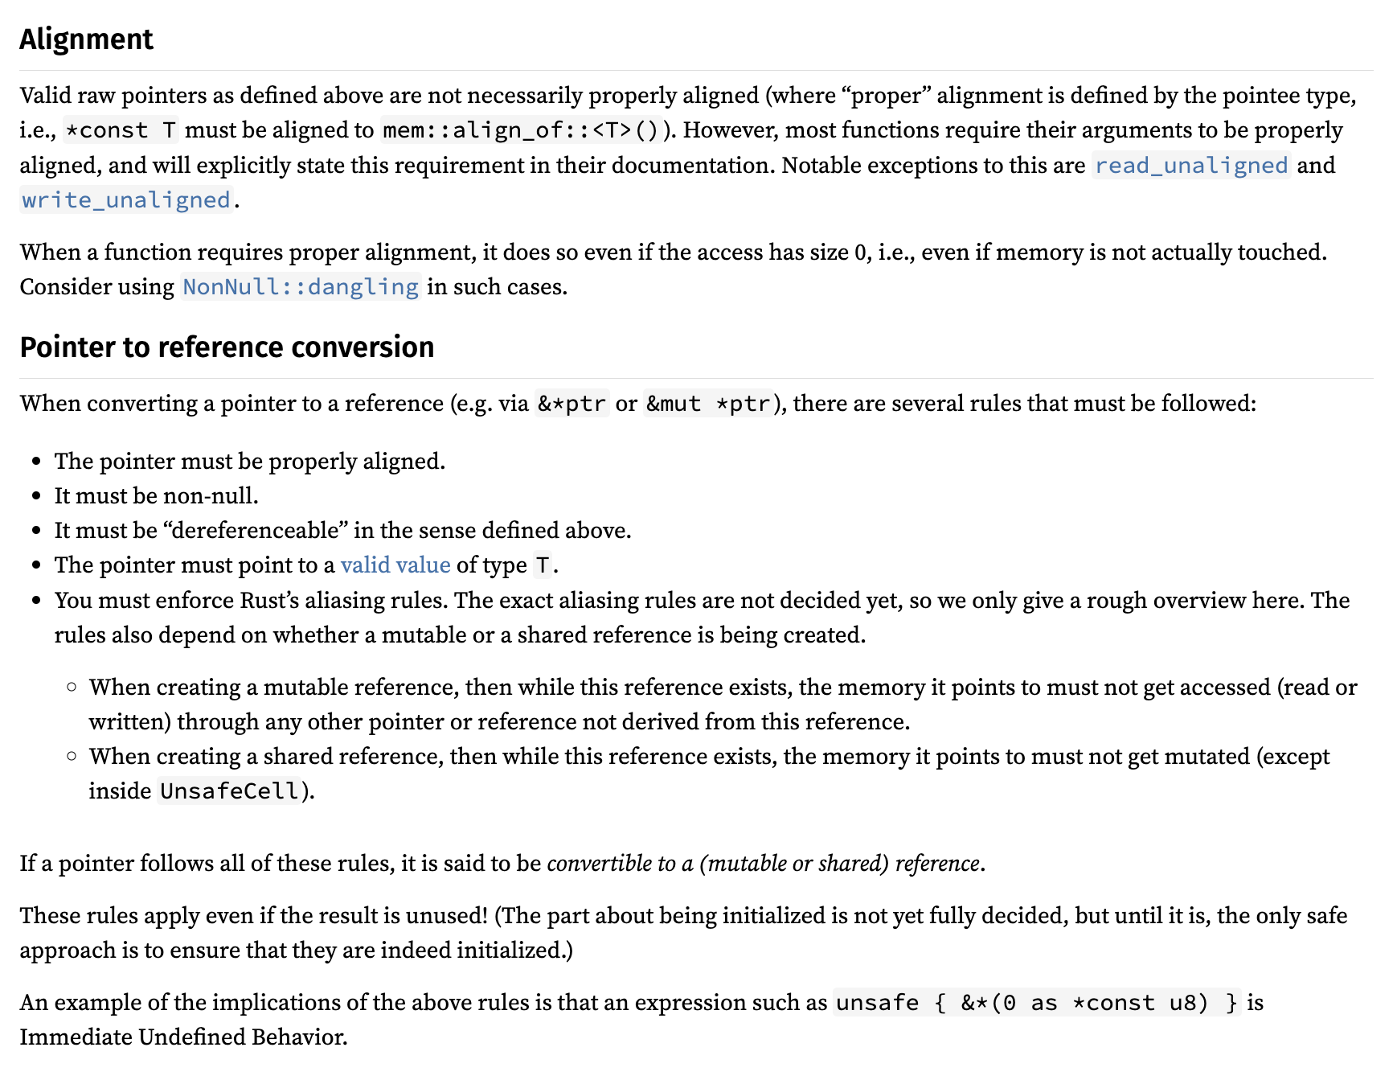
Let’s check the docs again

Slide 34
Let’s check the docs again

Slide 35
Pointers have a lot of conditions
Accessing a pointer requires:
Memory is valid, allocated, well-aligned
Reads must be initialized
Accesses are data-race-free
Playing nice with reference system (&T and &mut T)
Handling “pointer provenance”
Can these conditions even be expressed via Verus preconditions?

Slide 36

Isn’t this what ownership types are for?
Ordinarily, Rust’s type system, together with its clever standard library types (&T, &mut T, Box<T>, Rc<T>, Arc<T>, RefCell<T>, …), ensure that all the rules are followed
But the whole point of using “raw pointers” is that we can’t use those types…
Now we’re just going in circles!

Slide 37
Isn’t this what ownership types are for?
Ordinarily, Rust’s type system, together with its clever standard library types (&T, &mut T, Box<T>, Rc<T>, Arc<T>, RefCell<T>, …), ensure that all the rules are followed
But the whole point of using “raw pointers” is that we can’t use those types…
Solution: Decouple the ownership reasoning from the physical pointers; reason about ownership in “proof code”

Slide 38
Pointers have a lot of conditions
Accessing a pointer requires:
Memory is valid, allocated, well-aligned
Reads must be initialized
Accesses are data-race-free
Place nice with reference system (&T and &mut T)
Handling “pointer provenance”
For the demo & exercise, we’ll use Verus’s “Simple PPtr” library, which sands down the rougher edges at the cost of generality — but it still covers the key points

Slide 39
Notes:
Rope font is from: https://www.fontspace.com/category/rope

Slide 40
3 Main components of Concurrency
Memory permissions
?
Invariants

